Slide 1
Save TIME Save LIFE Adverse Food Effects
Author- Vinutha Shreekrishna

Slide 2
Adverse Food Effects
Preface:
Packaged food is the major source of food in United States across all age groups. Multivitamins & cosmetics are heavily used too. There are several levels of side effects due to packed food consumption, cosmetics usage & Multivitamins.
Project Goal:
Predicting Serious or Non-Serious Health injuries due to Adverse food effects using FDA Data

Slide 3
Project Milestones
Data Cleaning
Data Visualization with Exploratory Data Analysis
Building the model to predict the Serious or Non-Serious injuries
Potential Real Life Application

Slide 4
Data Cleaning
Data Source: https://www.kaggle.com/fda/adverse-food-events
Removed unwanted columns from Dataset to improve performance
Age feature cleansing
Creating “Dummy Variables” for Food Industry, Gender & Symptoms
Groping outcomes to serious and non-serious

Slide 5
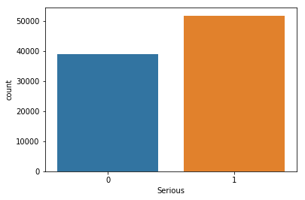
Data Visualization – Serious & non Serious in Original Dataset

Slide 6
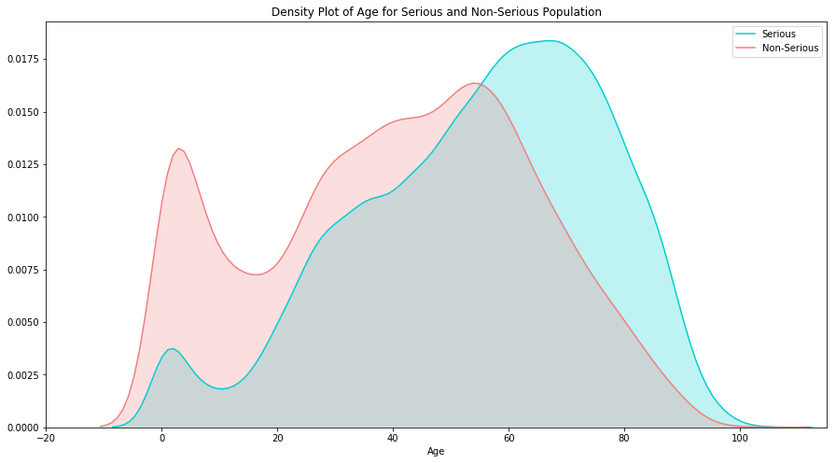
Data Visualization – Density Plot of Age for Serious and Non-Serious Population

Slide 7
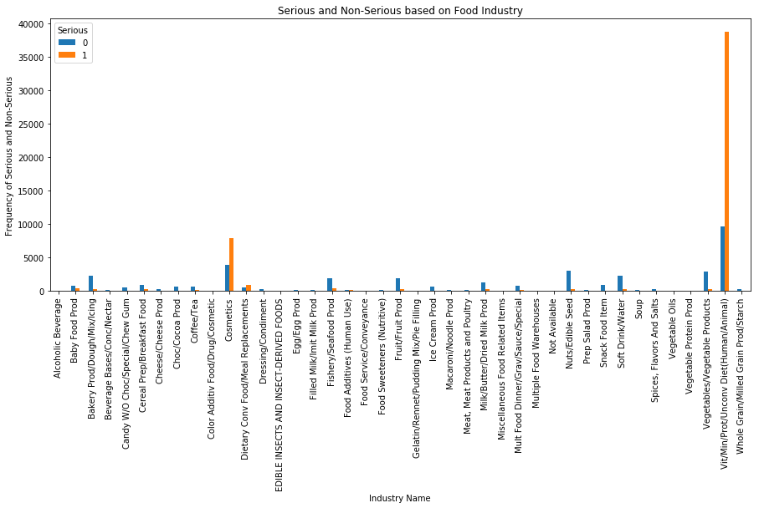
Data Visualization – Serious and Non-Serious By Food Industry

Slide 8
model to predict the Serious or Non-Serious injuries
Steps:
Split the dataset into Training and Test Dataset
Creating target and feature variables for training dataset
Build pipeline with imputation for age missing values, random forest classifier and gridserach cv
Fitting the training data to the pipeline model
Predicting the outcomes on the test datasets
Test accuracy of the predicted outcomes of the model using classification report, confusion matrix & AUROC score

Slide 9
Model Accuracy Report
Classification Report
Confusion Matrix
Accuracy Score
AU_ROC Score is 0.8428760169342552

Slide 10
Code & Model Location
This is the location of the final submission of the project with all the code and model classifier.
https://github.com/Vinuthask/Capstone-Project-1/blob/master/Adverse_Food_Effects_Final_Submission.ipynb

Slide 11
Potential Real Life Application
This model can be easily enhanced with all of food adverse data available from FDA
The enhanced model can then be used by all hospitals & clinics receptionist / nurse.
Based on what food being consumed and symptoms they can be easily categorized for immediate hospitalization or not, their doctor can be paged etc.
Emergency responders can use this for medical purpose too
Food habits: Individuals can easily asses how their food habit can turn to serious health issues and improve their diet.

Slide 12
Thank You

